Slide 1

Business Case 5: recommender system for online grocery cart
Analysis Paralysis
Alexandra Ordina
Bojan Stavrikj
Henrique Januário
Hugo Mentzingen

Slide 2



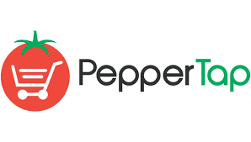

Online groceries
An emerging trend with big potential
Top-10 food and grocery markets in the world
No clear leader and fierce competition
india
INR 40 billion in 2015
Over 35% compound annual growth rate
Notes:
Bigbasket in industry context

Slide 3
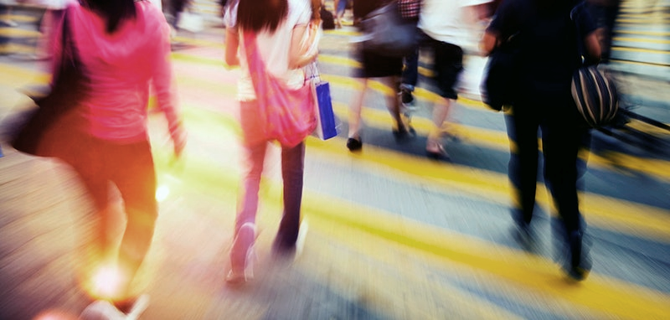
BUSINESS PROBLEMS
Lost revenue when clients buy forgotten goods elsewhere
Full inventory too long to browse
Not fit for smartphone users
Clients lost to competitors
UNDERESTIMATION HAS
RISKS TO REPUTATION

Slide 4

What will make bigbasket stand out?

Slide 5

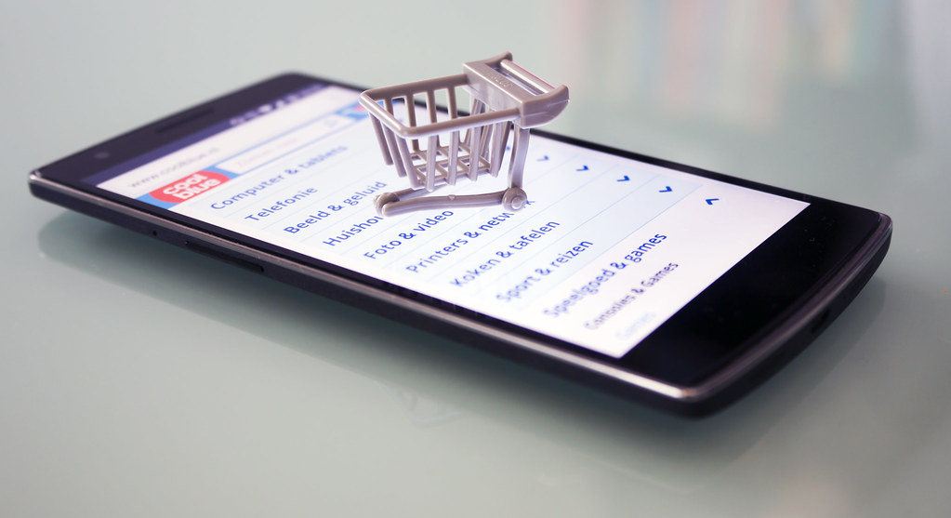
BUSINESS OBJECTIVES
Make it the BEST
Shopping experience
Smart basket at check-in
“Did you forget” list at check-out
Customer convenience
shopping experience
Notes:
Narrow down the list of options povided to a user

Slide 6


APPROACH AND METHODOLOGY
2 METHODS:
CHECK-IN LIST BASED ON PURCHASE HISTORY : GOOGLE PAGE RANK
CHECK-OUT BASED ON SHOPPING CART CONTENTS : SIMILARITY COEFFICIENT
PERSONALIZED TO EACH USER
MEASURE THE SUCCESS
OFFLINE EVALUATION: SIMULATES ONLINE BUYING
MONTE-CARLO VALIDATION : RANDOM SAMPLING
4 years of data
Notes:
Offline evaluation simulates online behaviour and is much cheaper than survey and target groups
Random Monte-carlo approach ensures its as close to real buying scenario with NO bias)
5 different ways = 5 splits (different percent for cut-off)

Slide 7



MEASURE THE SUCCESS
F1 score
GOAL: MAKE USEFUL RECOMMENDATIONS
HOW MANY RECOMMENDATIONS WERE USEFUL
HOW MUCH RECOMMENDATIONS
AFFECTED USERS CHOICE
Notes:
HOW MANY RECOMMENDATIONS WERE USEFUL (TOTAL GOOD/TOTAL RECOMMENDATIONS)HOW MUCH RECOMMENDATIONS AFFECTED USERS` CHOICE (TOTAL GOOD/TOTAL BASKET)
F1 summarizes the precision-recall curve
Precision – result relevancy Recall – success of prediction

Slide 8

Our analysis

Slide 9
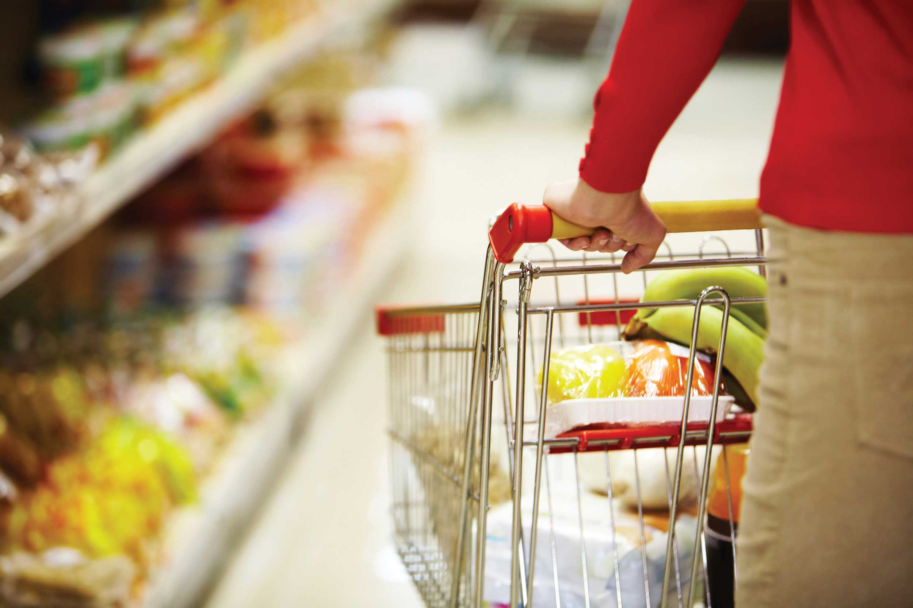
Value of historic data
CUSTOMER TRAFFIC
3 CUSTOMERS ORDERING EVERY HOUR
PEAK HOURS ARE 9 AM AND 19 PM
PEAK DAY: SUNDAY
AVG ORDERS 9 PER DAY
MAX 28 ORDERS PER DAY
SHOPPING BASKET
AVG 6 PRODUCTS
MIN 1 PRODUCT AND MAX 42
TOP 3: BEENS, ROOT AND OTHER VEGETABLES

Slide 10

Do people buy what we recommend?…
SMART BASKET
50% of clients use 3 out of 10 recommendations
10% of clients fill half of basket based on recommendations
Mean F1 score 0.25

Slide 11
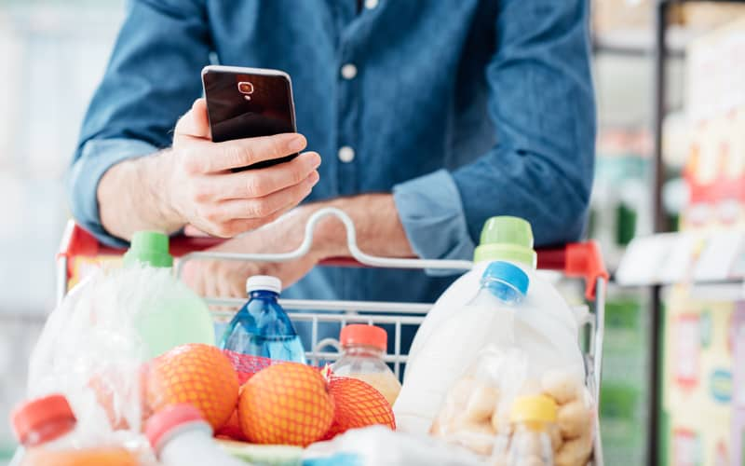
example SMART BASKET
Precision 0.7
Recall 0.5
F1 0.55
CLIENT X
AVERAGE BASKET : 8 ITEMS
WE PROPOSE 5 ITEMS AT CHECK-IN:
USER SELECTS 4 ITEMS
ADDS ANOTHER 4
Notes:
m99030

Slide 12
DID YOU FORGET?…
DID YOU FORGET LIST
Optimal number of “forgotten” items is 3
Most clients find at least 1 forgotten product on “Did you forget” screen
Mean F1 score 0.28
Mean Precision score 0.3

Slide 13
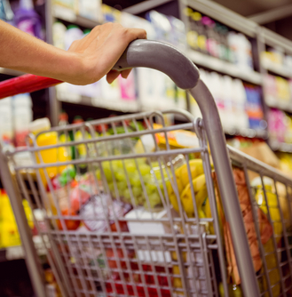
example did you forget
Precision 0.54
Recall 0.55
F1 0.54
CLIENT X
AVERAGE BASKET : 8 ITEMS
CLIENT HAS 5 ITEMS AT CHECK-OUT:
DID YOU FORGET 3?
CONFIRMS 2 AND PAYS
Notes:
Same client

Slide 14
Best e-shopping experience achieved!
USER-FRIENDLY SHOPPING LIST
CUSTOM REMINDER
NO MORE ENDLESS BROWSING
TAILORED TO EACH CLIENT
STIMULATES BUYING
BUILDS CUSTOMER SATISFACTION AND LOYALTY

Slide 15
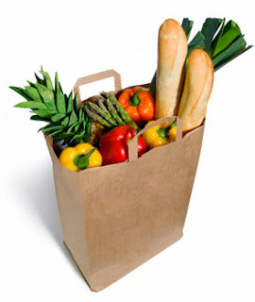




DEPLOYMENT
WEEKLY RUNS
Website & app
Strategy & client satisfaction
OPTIMAL RUN TIME:
SUNDAY OVERNIGHT
IT
Marketing
Procurement
Finance
PROCESSING POWER
Stock management
Project funding

Slide 16
FUTURE IMPROVEMENTS
ALLOW US TO WORK WITH YOUR DATABASE TO VALIDATE RESULTS
MORE DATA: CLIENT, PROMOTIONS, PRODUCT PRICE/NAME
KPI'S CAN BE DEVELOPPED FROM PREVIOUS POINT
TIMESTAMP USERS INTERACTIONS (LOG-IN TO PURCHASE)
SOLVE THE “FIRST TIME CLIENT” PROBLEM
CUSTOMIZE SIZE TO APP OR WEB

Slide 17



Thank you! Contact us:
Alexandra
Bojan
Henrique
Hugo

